Slide 1
Rating Prediction Project
By Surjeet Singh

Slide 2
Problem Statement
Nowdays every review has rating tagged to it
Train a machine learning model that can predict the rating of old review that has no rating tagged to it

Slide 3
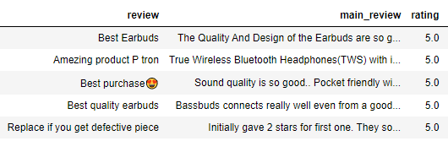
Data Collection
Data collected from the website of Amazon
Web scrapped 2 features
In the data cleaning part, following steps performed
1. Stopwords removal
2. Stemming
3. Lowered the case
4. Vectorize the data

Slide 4
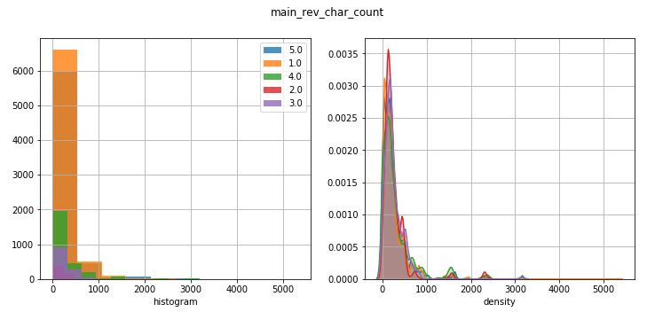
Data Analysis
Extracted some features such as sentence count, character count
Filtered the instances that has character length more than 1000

Slide 5
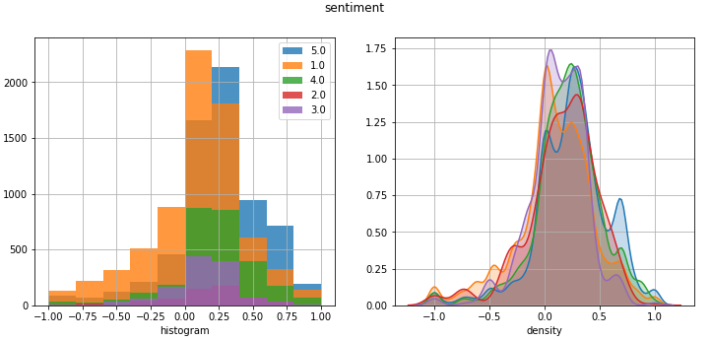
Sentiment Prediction
Sentiment of each review has been predicted using pretrained
model TextBlob
Reviews with high rating has positive sentiment whereas reviews
with low rating has negative sentiment

Slide 6
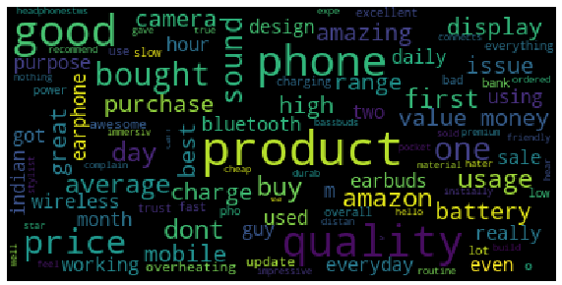
Word Cloud
Sentiment of each review has been predicted using pretrained
model TextBlob
Most frequently used word in the reviews are “product”, “phone”,
“good”, and “bought”

Slide 7
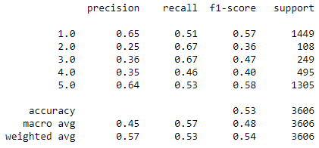
Machine Learning Models
Linear SVC

Slide 8
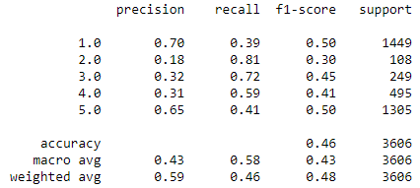
Machine Learning Models
Decision Tree

Slide 9
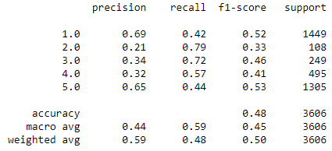
Machine Learning Models
Random Forest

Slide 10
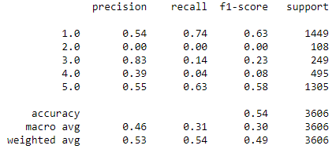
Machine Learning Models
Naïve Bayes

Slide 11
Conclusion & Future work
Naïve Bayes has maximum accuracy but it has zero f1 score for some of the classes
Random forest has a little bit less accuracy but it has better f1 score for all the classes
In future, I will use deep learning model to improve the accuracy such as LSTM or some pytorch bases models

